Slide 1
Do abstract examples really have advantages in learning math?
Johan Deprez, Dirk De Bock,
(Wim Van Dooren,) Michel Roelens, Lieven Verschaffel
slides: www.ua.ac.be/johan.deprez > Documenten

Slide 2

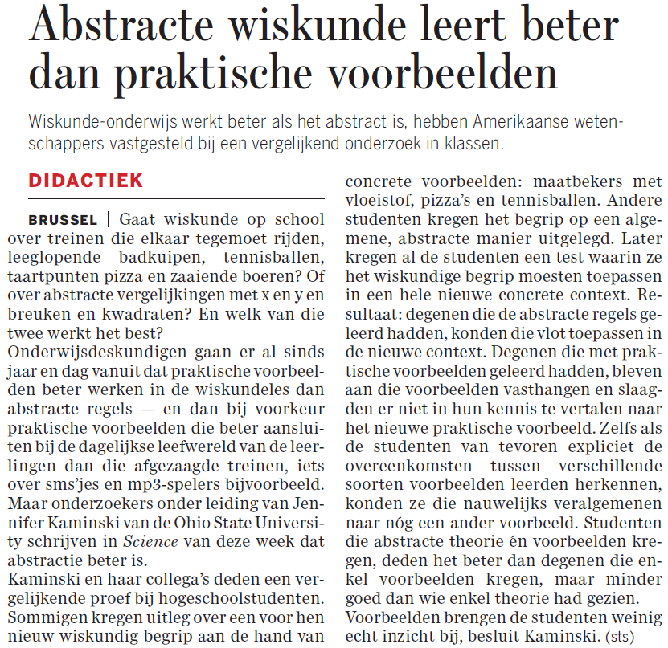
Abstract mathematics learns better than practical examples
Is mathematics about moving trains, …, sowing farmers? Or about abstract equations with x and y and fractions and squares? And which of both works best?

Slide 3
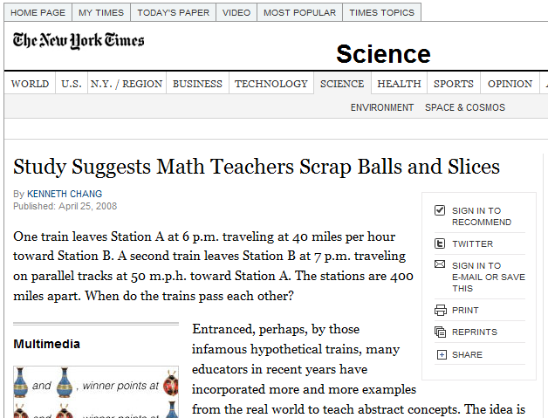

Slide 4

Les exemples sont mauvais pour l’apprentissage des mathématiques
(25 April 2008)
Examples are bad for learning math

Slide 5
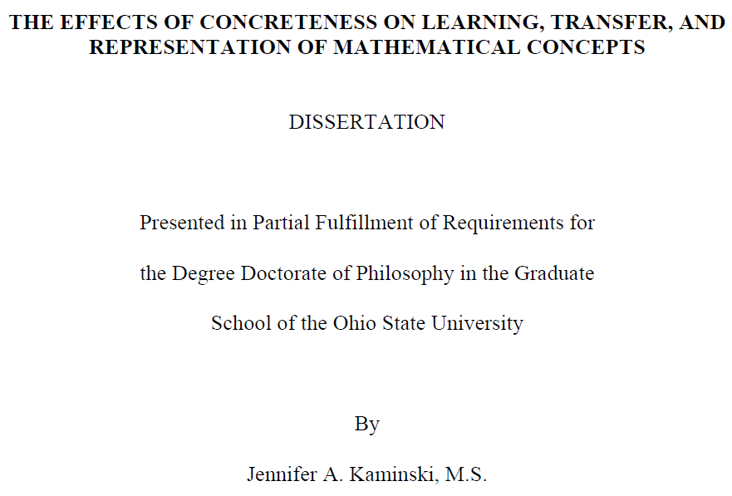
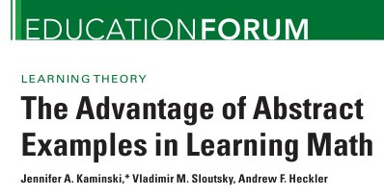
Introduction
newspaper articles based on
doctoral dissertation
Kaminski, J. A. (2006). The effects of concreteness on learning, transfer, and representation of mathematical concepts.
series of papers
…
Kaminski, J. A., Sloutsky, V. M., & Heckler, A. F. (2008). The advantage of abstract examples in learning math. Science, 320, 454–455.
…

Slide 6
Kaminski et al.
address the widespread belief in ‘from concrete to abstract’
“Instantiating an abstract concept in concrete contexts places the additional demand on the learner of ignoring irrelevant, salient superficial information, making the process of abstracting common structure more difficult than if a generic instantiation were considered”
(Kaminski, 2006, p. 114)
set up a series of controlled experiments
mainly with undergraduate students in psychology
(one experiment: 5th-6th grade school children)

Slide 7
Kaminski et al.
main conclusion (Kaminski et al., 2008, p. 455)
“If the goal of teaching mathematics is to produce knowledge that students can apply to multiple situations, then representing mathematical concepts through generic instantiations, such as traditional symbolic notation, may be more effective than a series of “good examples”.”

Slide 8
Critical reactions from researchers
in Educational Forum and e-letters in Science:
Cutrona, 2008
Mourrat, 2008
Podolefsky & Finkelstein, 2008
…
research commentary of Jones in JRME (2009)
informal reactions
McCallum, 2008
Deprez, 2008

Slide 9
In this presentation
Introduction
A taste of mathematics: commutative group of order 3
The study of Kaminski et al.
Critical review of the evidence for Kaminski et al’ s claims
based on critiques by other authors
and new critiques
Conclusions and discussion

Slide 10
A taste of mathematics: commutative group of order 3

Slide 11
Commutative group of order 3
a set G of 3 elements …
for example
{0,1,2}
{r_{120°}, r_{240°}, r_{0°}} , where for example r_{120°} denotes rotation
{a, b, c} where a, b and c are not specified
with an operation * defined on the elements …
{0,1,2}: addition modulo 3, for example: 2+2=1
{r_{120°}, r_{240°}, r_{0°}}: apply rotations successively, for example: first r_{120°}, then r_{240°} gives r_{0°}
{a, b, c} : the operation can be given by a 3 by 3 table
satisfying the following properties:

Slide 12
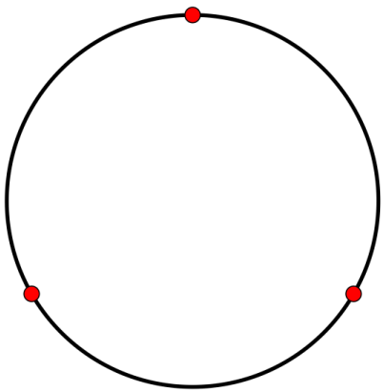
Commutative group of order 3
0
a set G of 3 elements …
with an operation * defined on the
elements …
satisfying the following properties:
commutativity: x*y=y*x for all x and y in G
associativity: (x*y)*z=x*(y*z) for all x, y and z in G
existence of identitiy: G contains an element n for which x*n=x=n*x for all x in G
existence of inverses: for every element x in G there is an element x’ for which x*x’=n=x’*x
the two examples are isomorphic groups
all groups of order 3 are isomorphic
name: cyclic group of order 3
2
1

Slide 13
The study of Kaminski et al.

Slide 14






The central experiment in Kaminski et al. (80 undergraduate students)
Phase 2:
Transfer domain
presentation + test
Phase 1: Learning domain
study + test
G: Tablets of an archeological dig
C1: Liquid containers
T: Children’s game
C2: Liquid containers + Pizza’s
C3: Liquid containers + Pizza’s
+ Tennis balls

Slide 15
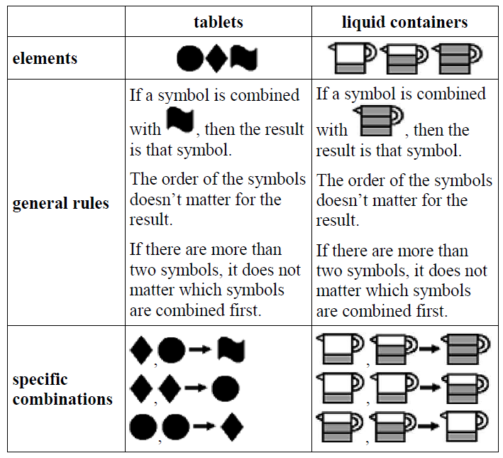
Phase 1
study:
introduction
explicit presentation of the rules using examples
questions with feedback
complex examples
summary of the rules
learning test:
24 multiple choice questions

Slide 16
Phase 2
presentation
introduction to the game
“The rules of the system you learned are like the rules of this game.”
12 examples of combinations
transfer test
24 multiple choice questions

Slide 17
Results
learning test: G = C1 = C2 = C3
transfer test: G > C1 = C2 = C3

Slide 18
Critical review of the evidence for Kaminski et al’ s claims

Slide 19
Critical review of the evidence for Kaminski et al’ s claims
Unfair comparison due to uncontrolled variables
What did students actually learn?
Nature of the transfer
Transfer of order 3 to order 4
Generalization to other areas?

Slide 20
1. Unfair comparison
Kaminski controlled for superficial similarity
undergraduate students read descriptions of T-G or T-C, but received no training of the rules
low similarity ratings
no differences in similarity ratings T-G vs T-C
critics: unfair comparison due to deep level similarity between T and G
(McCallum, 2008; Cutrona, 2009; Deprez, 2008; Jones, 2009a, 2009b; Mourrat, 2008, Podolefsky & Finkelstein, 2009)
G
C
T

Slide 21
1. Unfair comparison
prior knowledge
G and T:
arbitray symbols
operations governed by formal rules
ignore prior knowledge!
C: physical/numerical referent
physical/numerical referent for the symbols
physical/numerical referent for the operations
prior knowledge is useful!
G
C
T

Slide 22
1. Unfair comparison
central mathematical concept
G and T: commutative group
(commutativity, associativity, existence of identity element, existence of inverse elements)
C: commutative group (explicit)
vs. modular addition (implicit)
both are meaningful mathematical concepts
… but distinct (for higher order)!
G and C learn different concepts!
concept learned in G is more useful for T
G
C
T

Slide 23
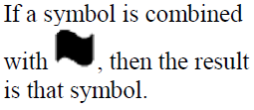
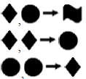
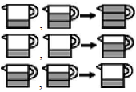
1. Unfair comparison
mathematical structure
G : neutral elt. n, 2 symmetric generators a and b
{n,a,b},
(1.1) a+a=b,
(1.2) b+b=a
(1.3) a+b=b+a=n
C: symmetry broken (1 vs. 2), one generator
{n,a,b}
(2.1) a+a=b
(2.2) a+a+a=n
equivalent, but focus on different aspects
G/C learned/ignored different aspects
in T: no clues for 2nd set of rules
G
C
1+1=2
1+1+1=3
T

Slide 24
1. Unfair comparison
Summary: G = T, wheras C ≠ T concerning
role of prior knowledge
central mathematical concept
mathematical structure
changing transfer task may give different results
replication and extension study by De Bock et al, PME34 RR (Tuesday 3:20 p.m., room 2015):
transfer task more similar to C than to G
unfair comparison in opposite sense
results transfer test: C > G

Slide 25
2. What did students actually learn?
Multiple choice questions in Kaminski’s experiments give no information about what students learned:
group properties?
modular addition?
mere application of formal rules?
…
study by De Bock et al, PME34 RR:
students G-condition mainly relied on specific rules

Slide 26
3. Nature of the transfer
Transfer in Kaminski’s experiments is
near transfer
immediate transfer
prompted transfer
… very different from real classroom situations!
(Jones, 2009)

Slide 27
4. Transfer of order 3 to order 4
experiment 6 in Kaminski’s dissertation
not published, as far as we know
our interpretation of her results
second transfer test
(cf. next slide, 10 questions)
about a cyclic group of order 4
= mathematical object next in complexity to group of order 3

Slide 28
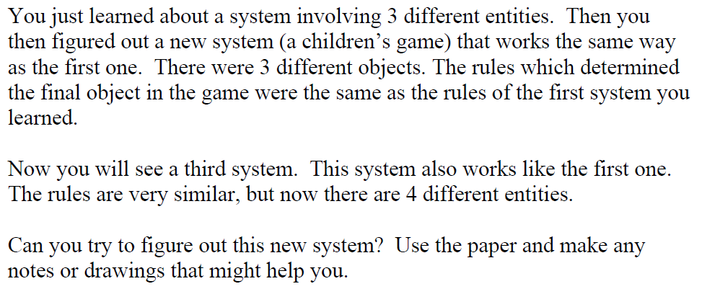
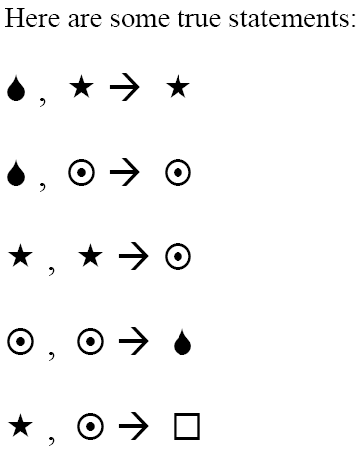
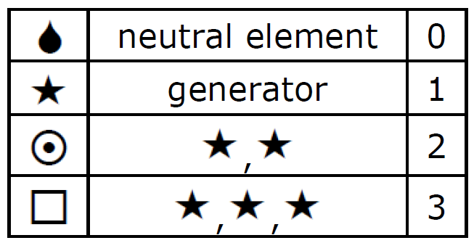
2. Transfer to a group of order 4

Slide 29
4. Transfer of order 3 to order 4
first learning condition of this new experiment
= G-learning condition in the basic experiment (clay tablets)
bad results for the order 4 transfer test: not better than chance level (Kaminski, 2006, p. 95)
our interpretation
important limitations to transfer from G learning condition!
concept of modular addition is not learned by G-participants

Slide 30
4. Transfer of order 3 to order 4
second learning condition
G-learning condition from basic
experiment + ‘relational diagram’
(i.e. “diagram containing minimal
amount of extraneous information”)
good results on the order 4 transfer test
our interpretation
diagram contains vital structural
information not present in verbal
description: cyclic structure of the
group
(equivalent to modular addition)
0
2
1

Slide 31
4. Transfer of order 3 to order 4
third learning condition
concrete learning domain with
a ‘graphical display’
good results on the order 4
transfer test
our interpretation
successful transfer from a concrete learning condition!
display and/or concrete referent contains supplementary structural information: cyclic structure of the group

Slide 32
4. Transfer of order 3 to order 4
Summary:
No transfer from generic example to group of order 4.
Successful transfer from concrete example to group of order 4.
Kaminski’s conclusions about transfer from generic/abstract and concrete examples are not that straightforward as the title of her Science paper suggests!

Slide 33
5. Generalization to other areas?
Kaminski et al. in Science, 2008, p. 455
“Moreover, because the concept used in this research involved basic mathematical principles and test questions both novel and complex, these findings could likely be generalized to other areas of mathematics. For example, solution strategies may be less likely to transfer from problems involving moving trains or changing water levels than from problems involving only variables and numbers.”
a lot of critics expressed their doubts
a specific question about generalizability:
Can we construct a generic learning domain in Kaminski’s style for objects next in complexity, i.e. cyclic groups of order 4 and higher?

Slide 34
5. Generalization to other areas?
Can we construct a generic learning domain in Kaminski’s style for objects next in complexity, i.e. cyclic groups of order 4 and higher?
order 3: neutral elt. n, 2 symmetric generators a & b
{n,a,b},
(1.1) a+a=b,
(1.2) b+b=a
(1.3) a+b=b+a=n
Cayley table of the commutative group of order 3
 | n | a | b
n
a
b
 | n | a | b
n | n | a | b
a | a
b | b
 | n | a | b
n | n | a | b
a | a | b | n
b | b |  | a
 | n | a | b
n | n | a | b
a | a | b | n
b | b | n | a

Slide 35
5. Generalization to other areas?
Generic learning domain in Kaminski’s style for cyclic groups of order 4 and higher?
Cayley table of the cyclic group of order 4
(one of the two groups of order 4)
16 cells
9 left after using rule of neutral element
3+2+1 = 6 specific rules
3 remaining cells by using rule of commutativity
 | n | a | b | c
n
a
b
c
 | n | a | b | c
n | n | a | b | c
a | a
b | b
c | c
 | n | a | b | c
n | n | a | b | c
a | a | b | c | n
b | b |  | n | a
c | c |  |  | b
 | n | a | b | c
n | n | a | b | c
a | a | b | c | n
b | b | c | n | a
c | c | n | a | b

Slide 36
5. Generalization to other areas?
 | n | a | b | c
n | n | a | b | c
a | a | b | c | n
b | b | c | n | a
c | c | n | a | b
Cyclic groups of order …
… 5: 4+3+2+1 = 10 specific rules
… 6: 5+4+3+2+1 = 15 specific rules
7, 8, 9, …: 21, 28, 36, … specific rules
De Bock et al, PME34 RR: students in G-condition in Kaminski’s experiment mainly relied on the specific rules
Probably, a generic learning domain in Kaminski’s style for cyclic groups of order 4 and higher will not lead to successful learning nor to succesful transfer.

Slide 37
Conclusions and discussion
An overview of critiques
differences in deep level similarity to transfer domain between G- and C-condition
doubts as to whether students really learned groups
transfer in Kaminski’s experiments is quite different from typical educational settings
an experiment of Kaminski showing
no transfer from G-condition
successful transfer from a C-condition
plausibly, generic learning domain in Kaminski’s style for cyclic groups of order 4 and higher will not lead to successful learning/ transfer

Slide 38
Conclusions and discussion
An overview of critiques
…
These results seriously weaken Kaminski et al.’s affirmative conclusions about “the advantage of abstract examples” and the generalizability of their results.

Slide 39
Thank you for your attention!
slides:
www.ua.ac.be/johan.deprez > Documenten

